Slide 1

Data Transformation

Slide 2
Data Transformation
A function that maps the entire set of values of a given attribute to a new set of replacement values so that each old value can be identified with one of the new values
Methods
Smoothing: Remove noise from data
Attribute/feature construction
New attributes constructed from the given ones
Aggregation: Summarization, data cube construction
Normalization/Standardization: Scaled to fall within a smaller, specified range.
min-max normalization
z-score normalization
normalization by decimal scaling

Slide 3
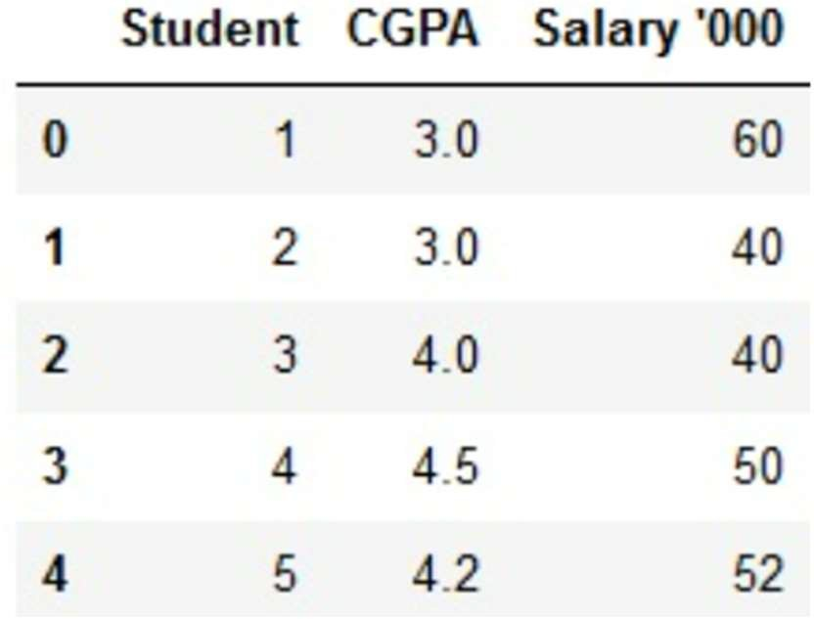
Feature Scaling
to transform the values of features or variables in a dataset to a similar scale.
to ensure that all features contribute equally to the model and to avoid the domination of features with larger values.
dealing with datasets containing features that have different ranges, units of measurement, or orders of magnitude. In such cases, the variation in feature values can lead to biased model performance or difficulties during the learning process.
•
•
Standardization
Normalization

Slide 4
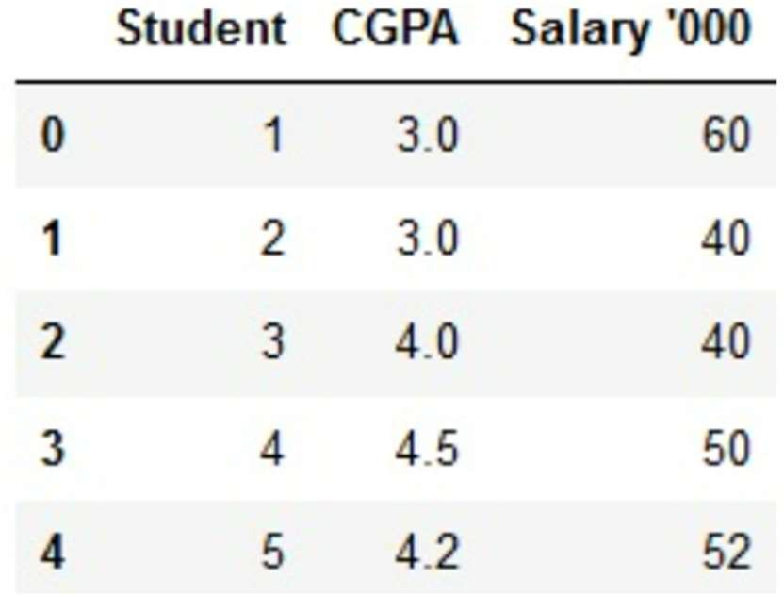
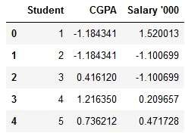
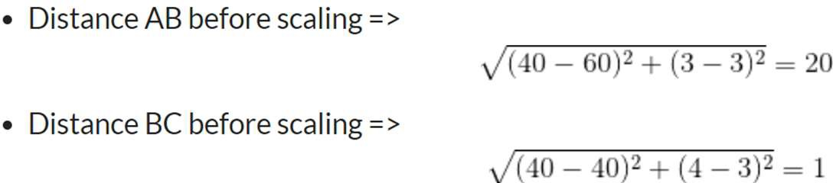
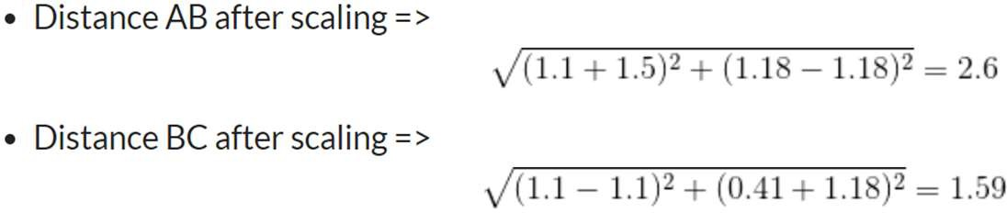
Feature Scaling: Distance based alg

Slide 5
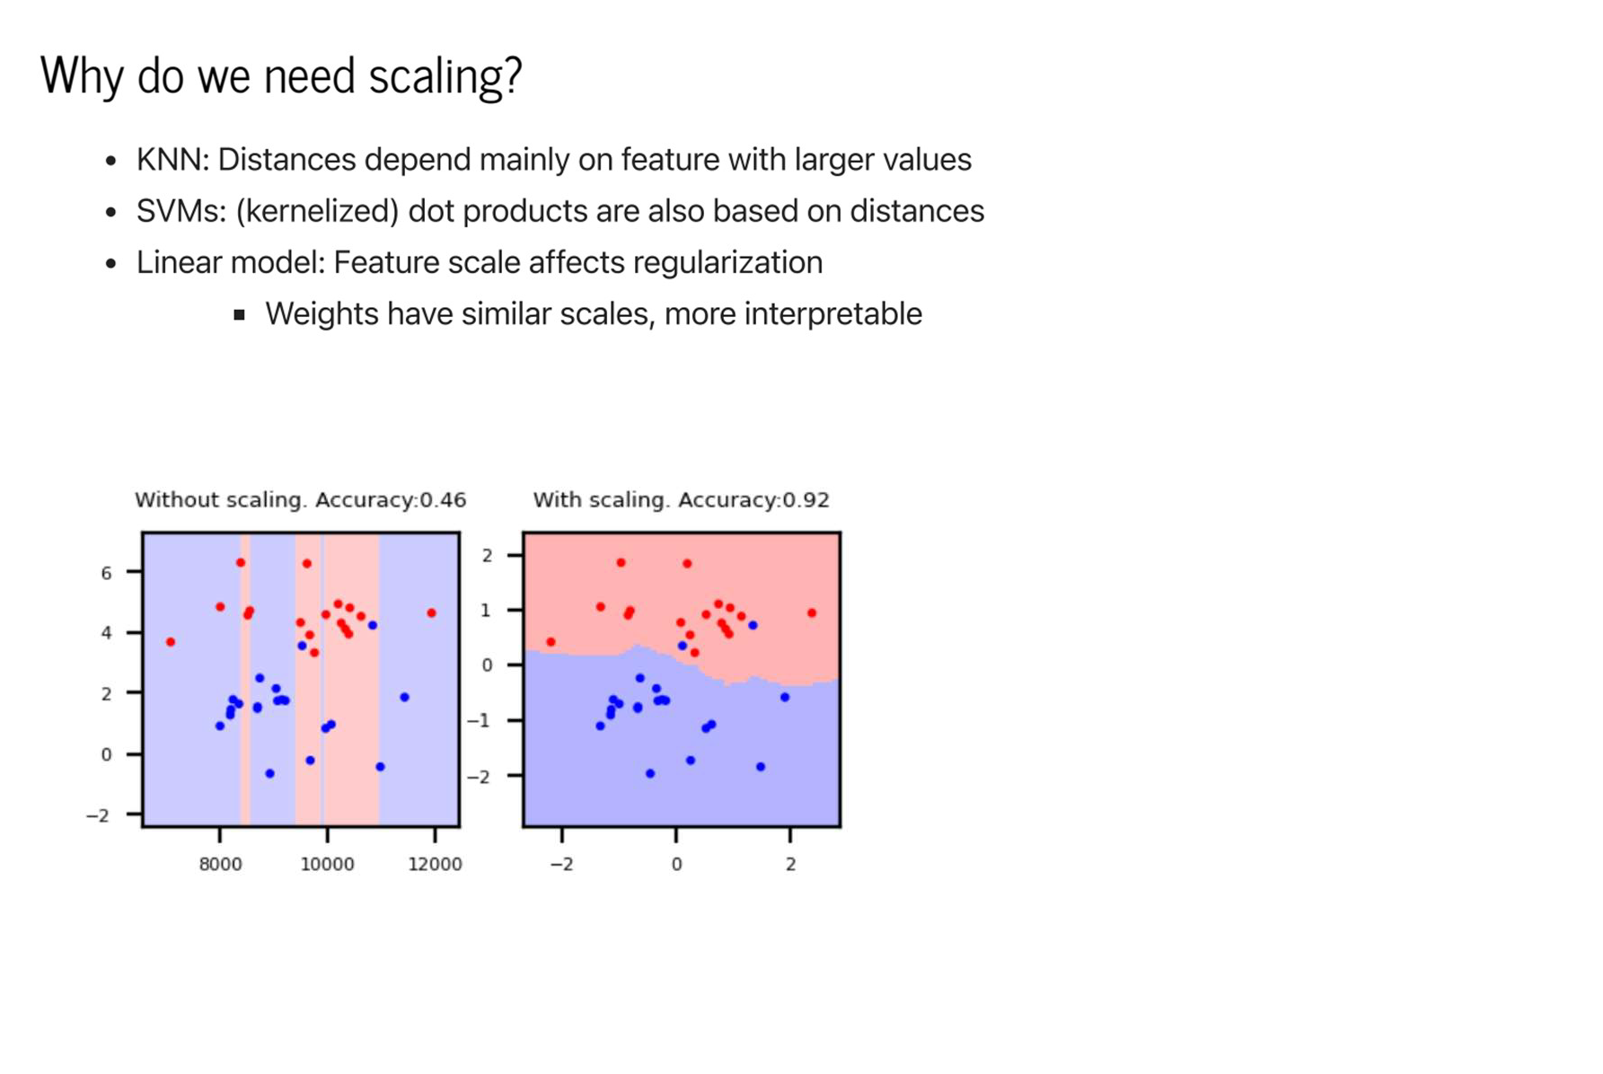

Slide 6
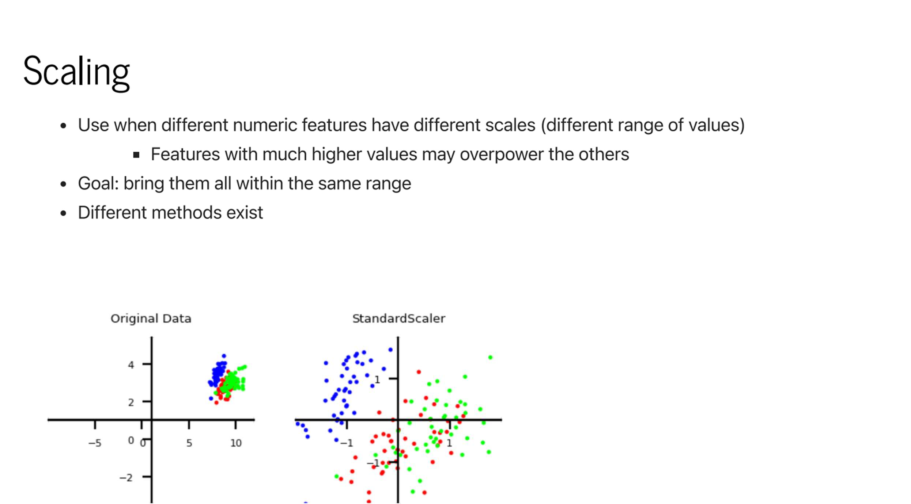

Slide 7
Standardization
values are centred around the mean with a unit standard deviation.
The mean of the attribute becomes zero, and the resultant distribution has a unit standard deviation.

Slide 8
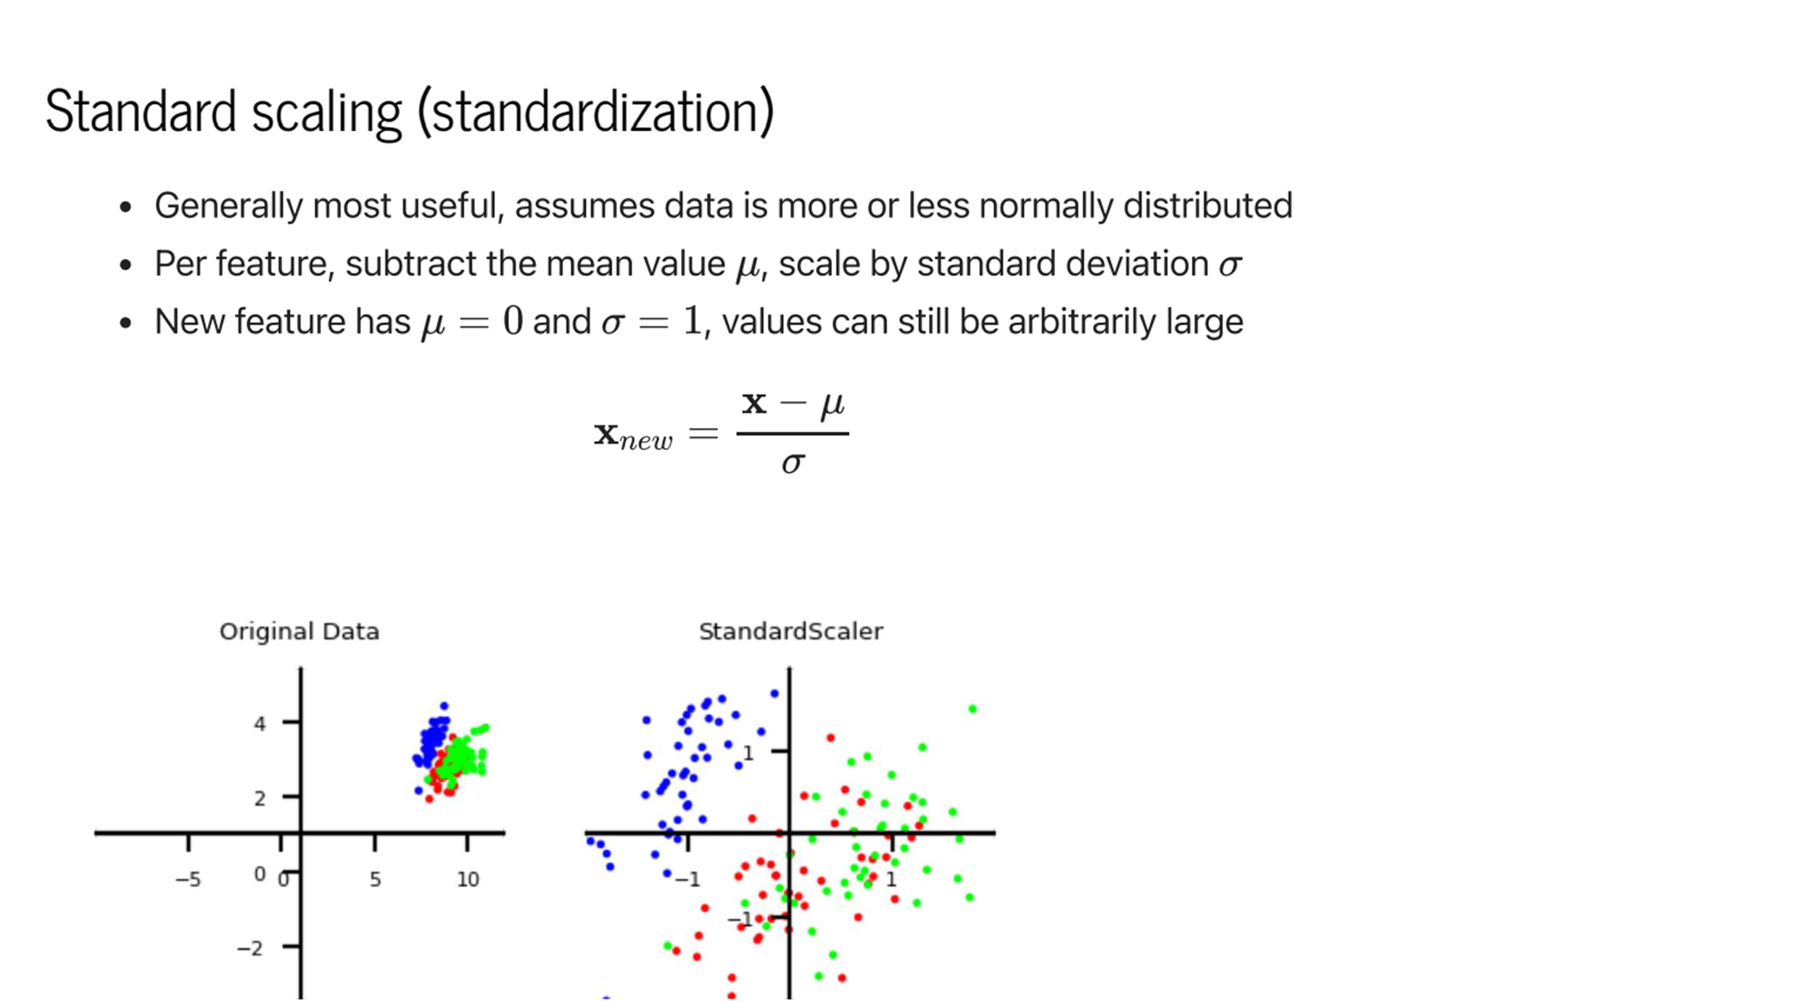

Slide 9
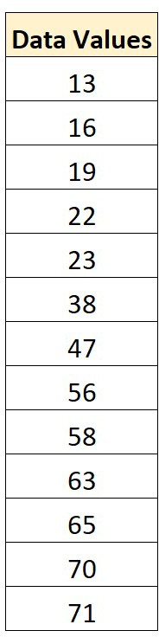
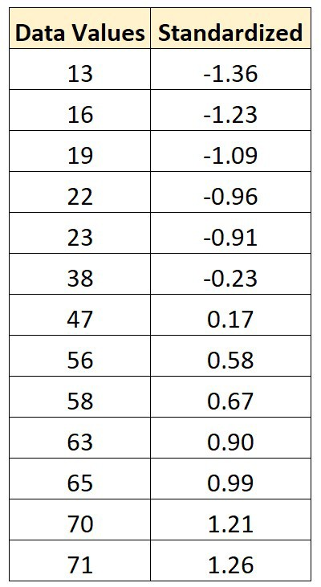
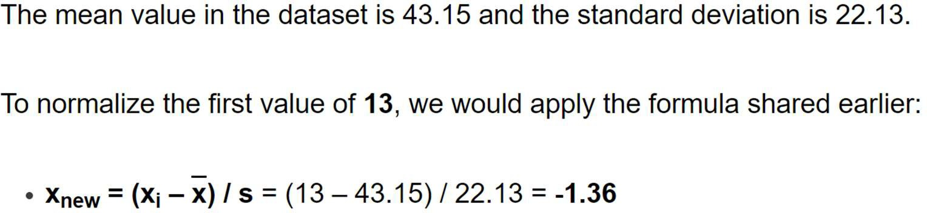

Slide 10
Normalization
to adjust the values of features in a dataset to a common scale.
to facilitate data analysis and modeling, and to reduce the impact of different scales on the accuracy of machine learning models.
Normalization is a scaling technique in which values are shifted and rescaled so that they end up ranging between 0 and 1.

Slide 11
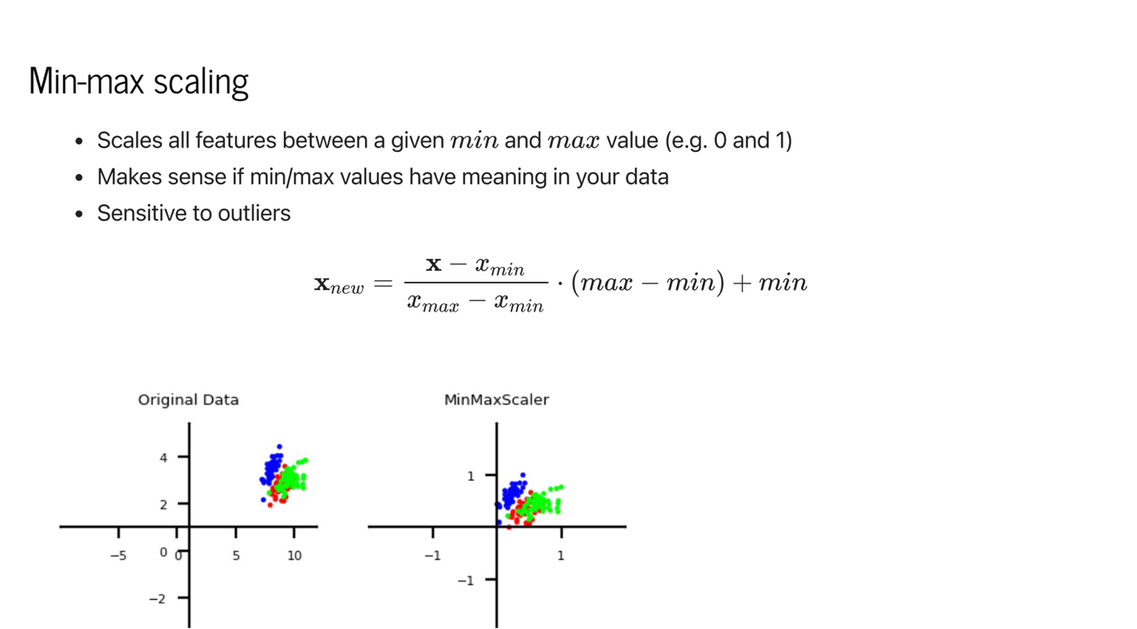

Slide 12
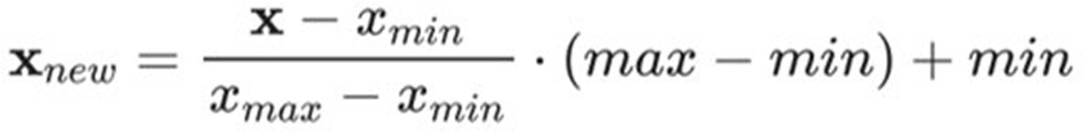
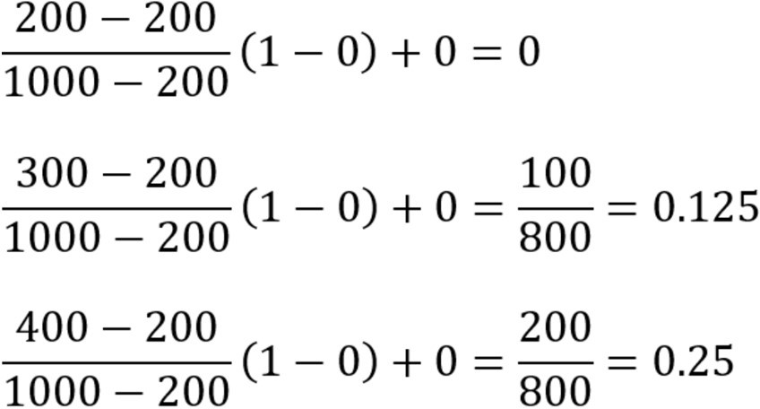
Example
normalize the following data
set, 200, 300, 400, 600, 1000 to a new range [0, 1], then using min-max normalization
xmin = 200, xmax = 1000,
min = 0, max = 1

Slide 13
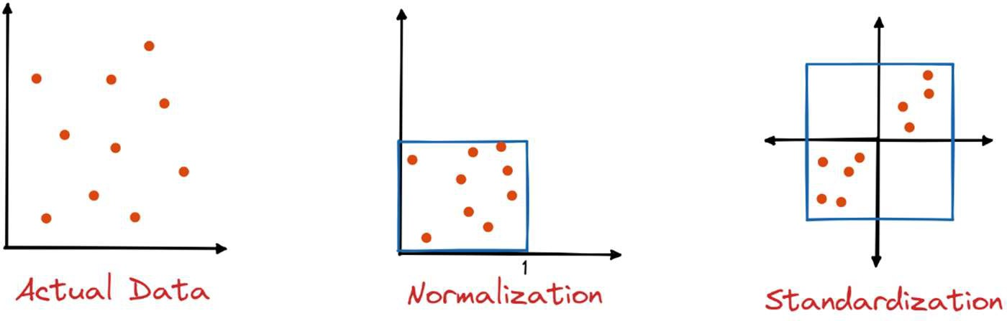
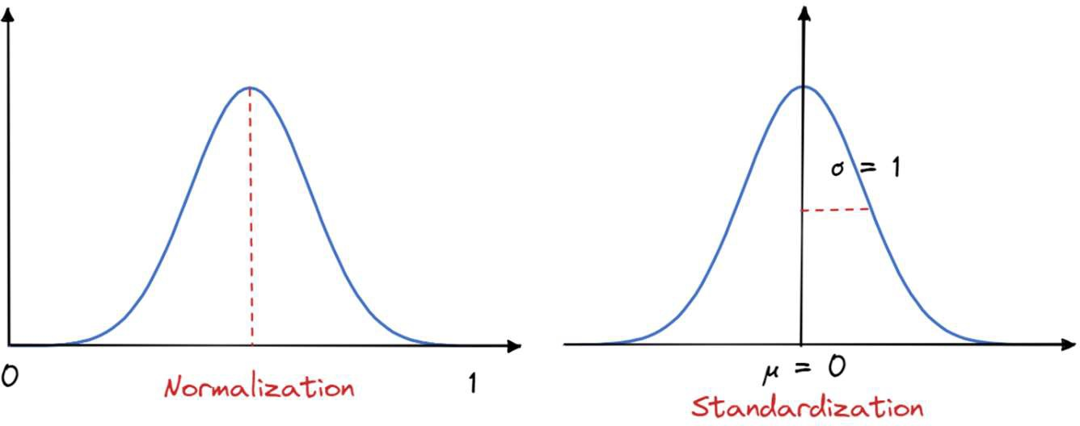

Slide 14
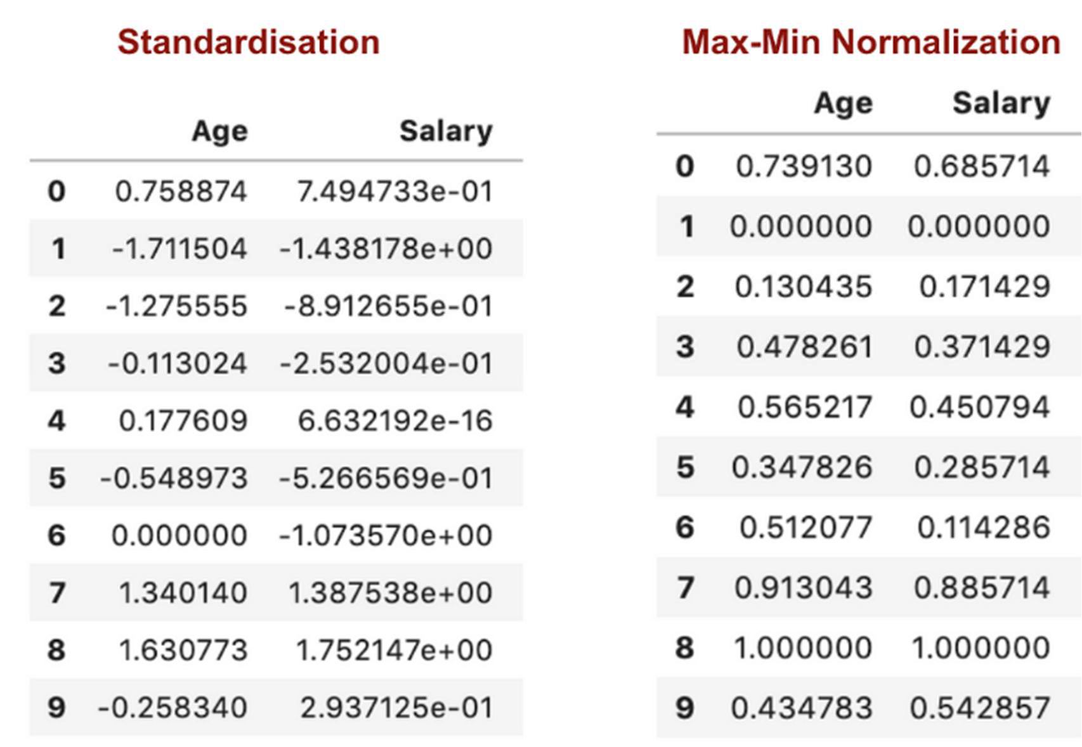

Slide 15
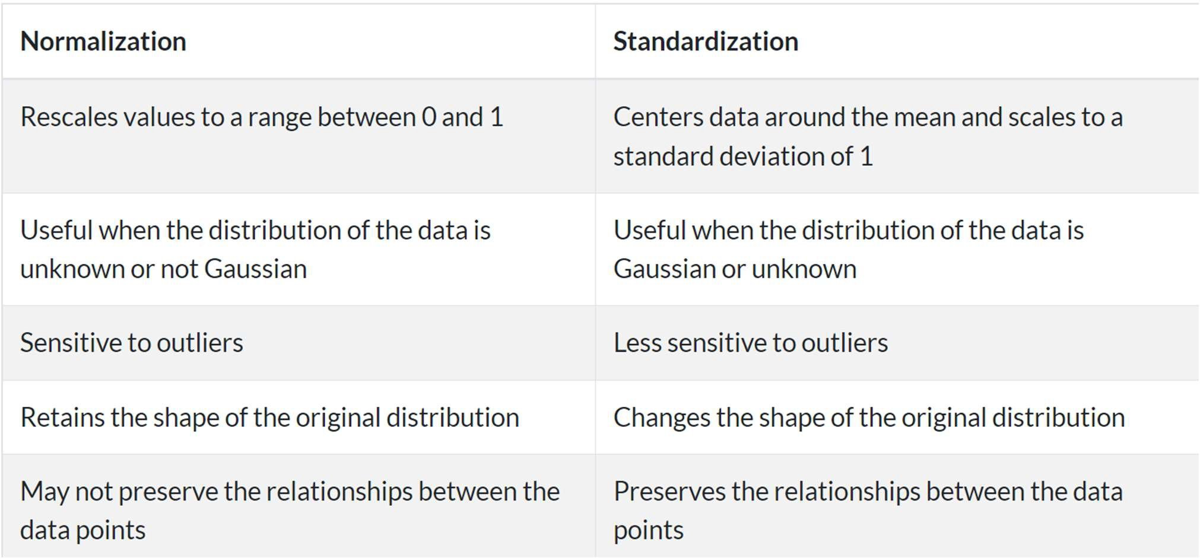
Difference

Slide 16
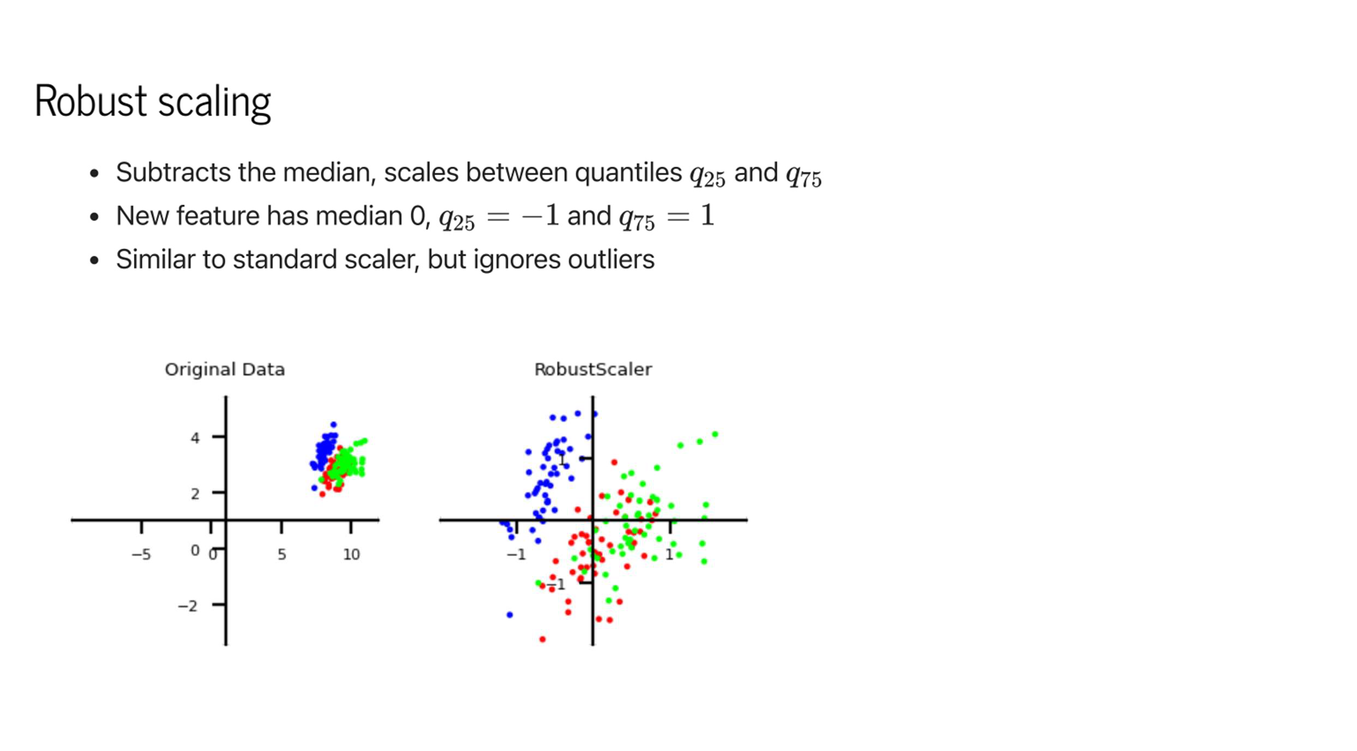

Slide 17
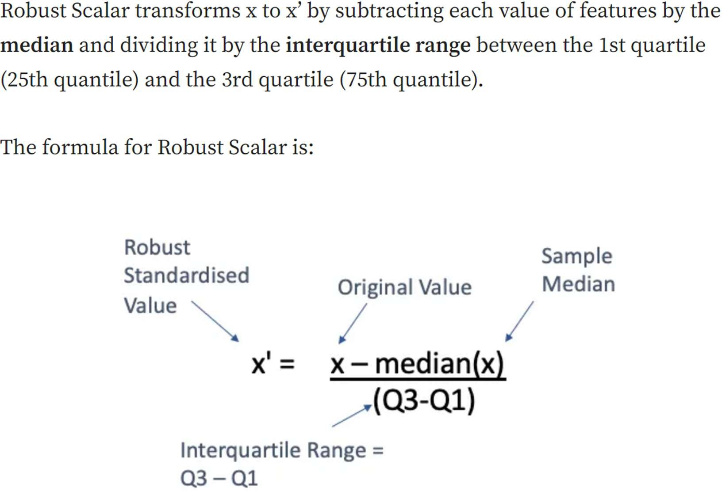

Slide 18
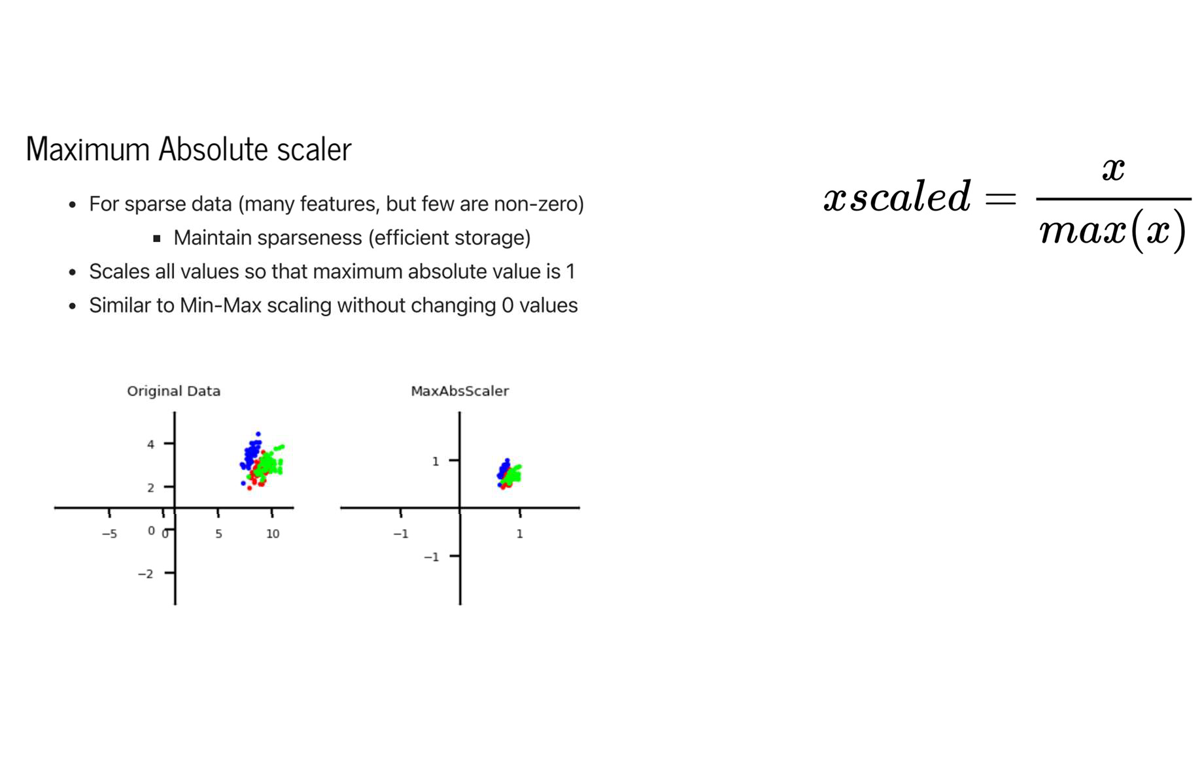

Slide 19
Normalization
Min-max normalization: to [new_min_{A}, new_max_{A}]
v' =
v − minA
(new _ maxA − new _ minA) + new _ minA
maxA − minA
Ex. Let income range $12,000 to $98,000 normalized to [0.0, 1.0]. Then
$73,000 is mapped to
^{73,600 −12,000} (1.0 − 0) + 0 = 0.716
98,000 −12,000
Z-score normalization (μ: mean, σ: standard deviation):
_{v ' =} v −  A
⬧ A
73,600 − 54,000 _{= 1.225}
Ex. Let μ = 54,000, σ = 16,000. Then
16,000
Normalizatio_{v}n by decimal scaling
v' =
Where j is the smallest integer such that Max(|ν’|) < 1
10 ^{j}
-10, 201, 301, -401, 501, 601, 701 Maximum absolute value: 701 Divide the given data by
1000 (i.e j=3) Result: The normalized data is: -0.01, 0.201, 0.301, -0.401, 0.501, 0.601, 0.701

